Slide 1
Meeting with Oksana
17/04

Slide 2
Tasks From Last Meeting
Experiment adding a weighted average after the classification task before computing the loss, turning the problem into a regression.
Finish V2E installation
Generate the IsaacSim dataset 10ms with shadow

Slide 3
Completed Tasks

Slide 4
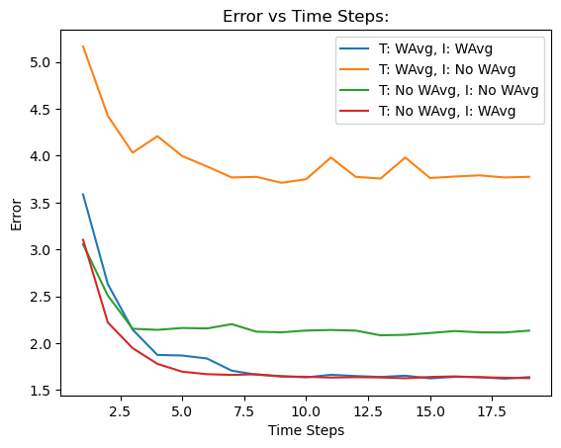
Weighted Average SNN
Training takes more epochs, but increases accuracy (for videos)
I played around with combinations of WeightedAvg during training and inference:
Inference ~ 12ms

Slide 5

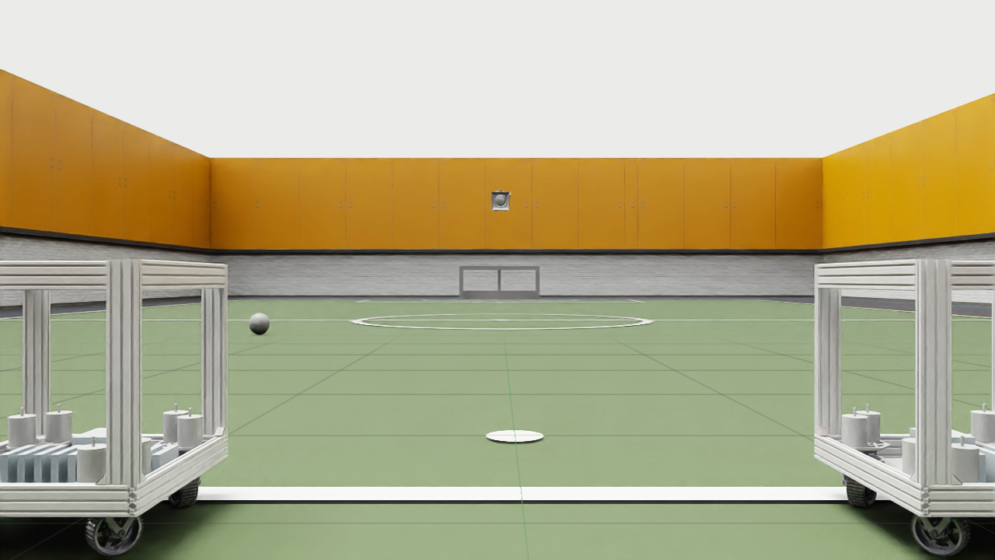
V2CE is installed

Slide 6
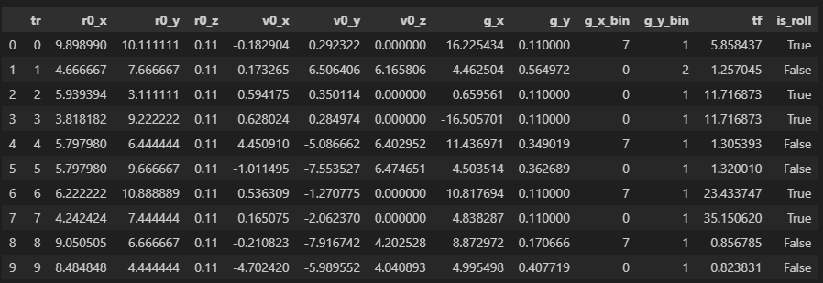
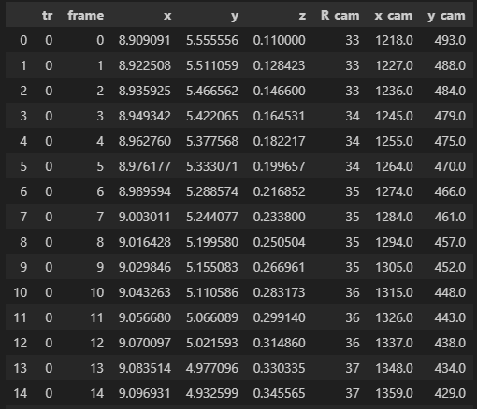
Dataset generation
Changed the ball roll model
Approach
Trajectories that go out 10%
Trajectories that go in 80%
Trajectories that go almost in (small margin) 10%
Throw to ball ratio?

Slide 7
Meeting with Guangzhi
I shouldn’t stress that much about the architecture
Inference speed on deployment depends more on whether the architecture is optimized for the hardware than on the architecture itself.
Just solve the problem and then make the network faster
Distillation techniques like weight quantization
PINN approach

Slide 8
Ongoing and Proposed Future Tasks

Slide 9
Ongoing Tasks
Creation of the dataset
I still need to look into the FOV of IsaacSim vs the FOV in my simulation of the trajectory
That’s because I crop the frames in which the ball is not in the FOV
V2CE
I am not fully convinced by the results of V2CE
There are some artifacts

Slide 10
Proposed Future Tasks
Change flight time to time to hit the goal

